Slide 1
CIS 8040 Fundamentals of Database Management Systems Veda C. Storey (vstorey@gsu.edu) I am on a journey to help my students succeed. Please come with me.
Course INTRODUCTION

Slide 2
Course Learning Objectives
Understand basic concepts and principles of database management systems.
Create a valid conceptual model of a database application.
Chen’s notation
Crows Feet notation
Design and implement a relational database (Oracle).
Use SQL queries to create and query a complete database.
Understand the major aspects of database administration and database applications.
Understand data warehouses and their role in business intelligence.
Appreciate trends in database technology and use (as time permits)
Big data management
Disruptive technologies
Privacy, security, ethics
Identify, understand, and communicate the business implications and impact of data management (written and oral)

Slide 3
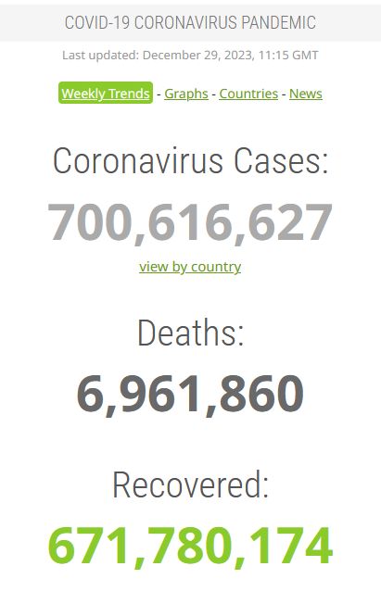
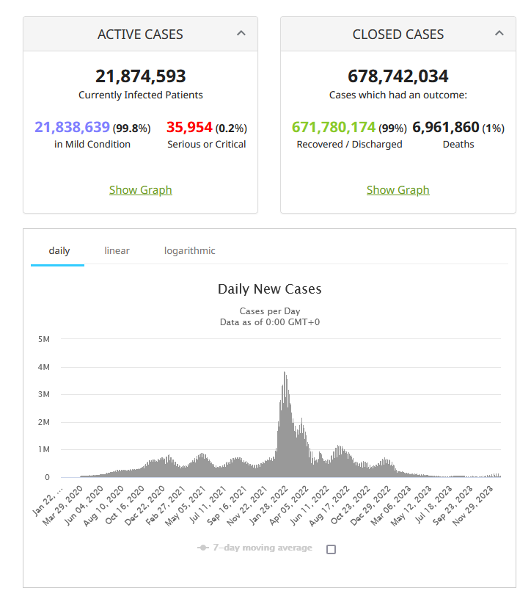
Data: This course is about data
How do we collect data?
How do we represent data?
How do we use data?
Source: https://www.worldometers.info/coronavirus/

Slide 4
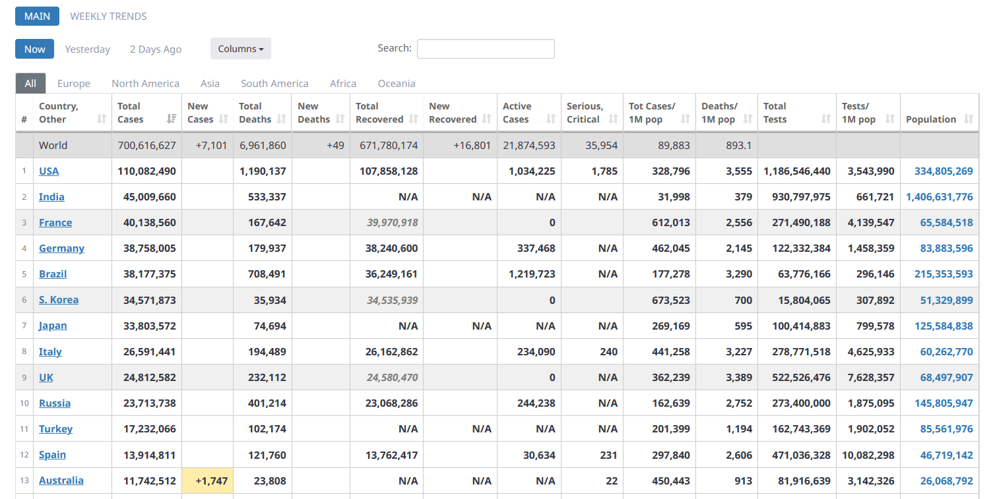
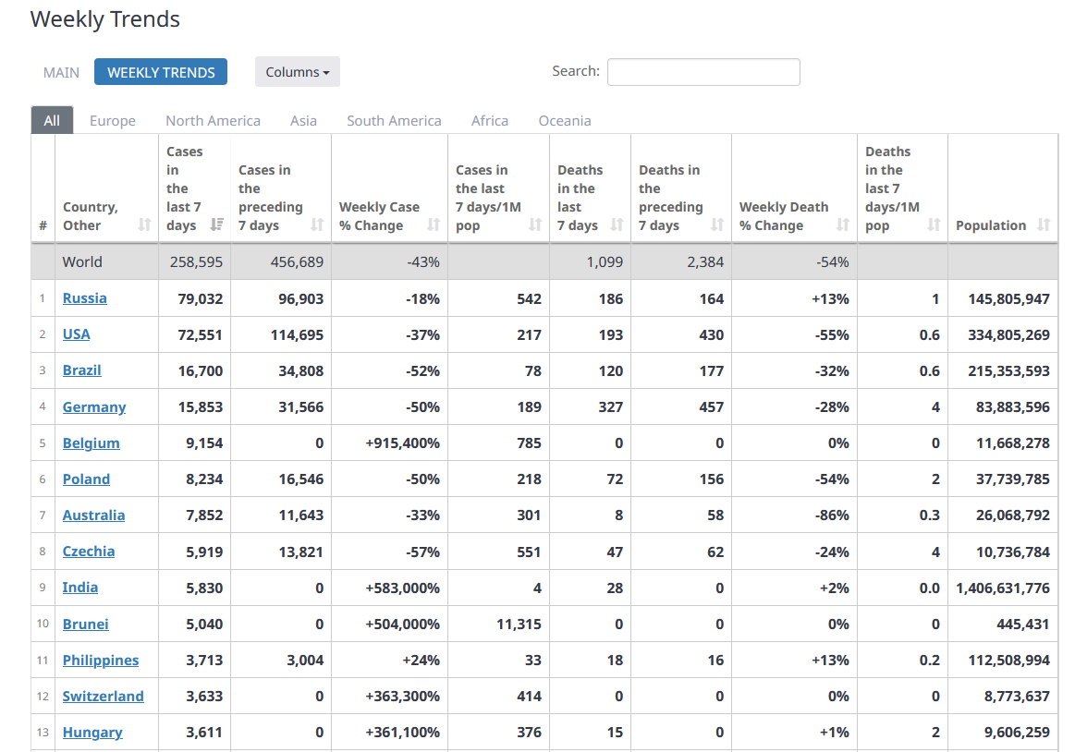
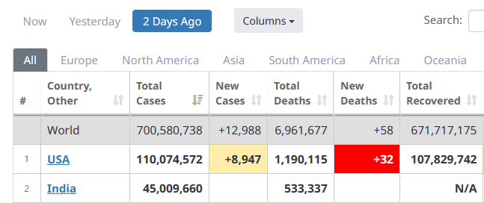
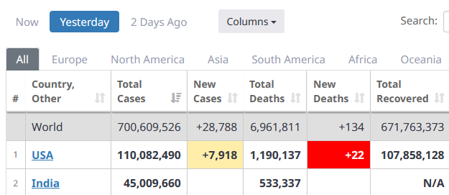

Slide 5

Why do we care about data?
Data as basis for decision making
Drivers to data acquisition (3)
Automated data capture
how?
Telecommunications
removes distance
Powerful processing capabilities

Slide 6
What is a database, exactly?
A database is a set of data that has a regular structure and is organized in such a way that a computer can easily retrieve the desired results.
(Well, a good one is, anyway)
Important: Need to be able to store and retrieved data need.
Requires: data availability and data manipulation capabilities

Slide 7
What is a database management system (DBMS)?
Software package
Create, implement, and use database
Oracle (GSU accounts for students)
Tools
Querying, security/privacy, handling multiple users
This course
Design, develop, and use a database
Understand the notion of “data as a corporate asset”
Identify and communicate impact of data management on organization

Slide 8
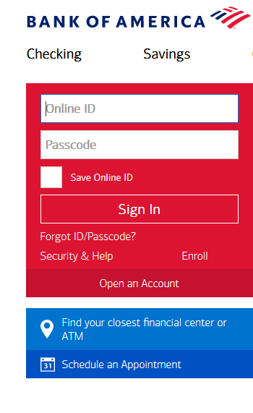
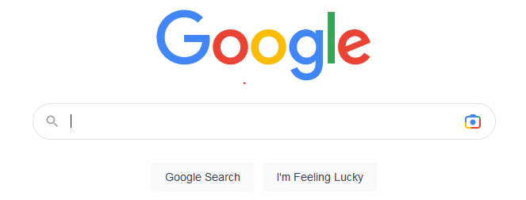
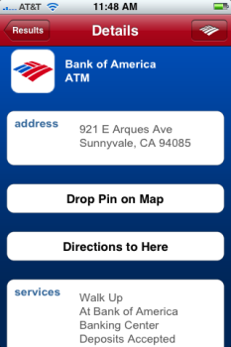
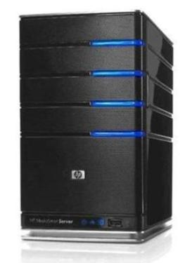

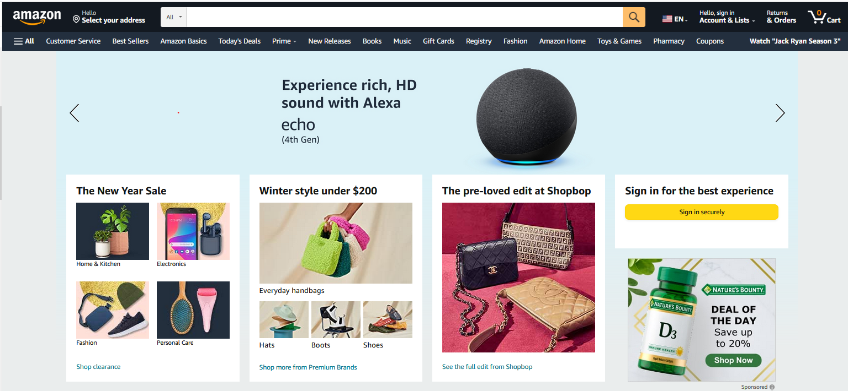

Database System
Database System
Raw data must be protected.
Database Application
(e.g., banking)
Database Application
Database Management System (DBMS)
(software)
Database

Slide 9
Uses of Database Management System (DBMS)
Archive data
For later use, trend analysis, legal requirements
Transactions (OLTP – Online Transaction Processing)
Point of Sale (POS)
Banking
Analysis (OLAP – Online Analytic Processing)
Business Intelligence/Data Mining
Real-time Data
GPS
Applications
Many, many applications for business and personal applications.
Examples?

Slide 10
Business Today
Organizations, information technology, and processes are all inter-dependent
Change in one affects another
Example: information technology can support a virtual organization; impact on processes?
What are the implications of today’s online data management?
Organizations
Information
Technology
Processes
Notes:
10
Recall primary issues of security: confidentiality, integrity, and availability.
How does this relate to privacy and ethics?
Role of databases and database management?
Requirements to protect customer data.

Slide 11
Course Overview
Create
Conceptual Modeling
Insert
Logical Modeling
Database
Update
Deleting
Physical Modeling
Querying
Security
DBMS
Privacy
Big Data
Multi-User
Triggers

Slide 12
Textbook
Kroenke, D., & Auer, D. J. (2022). Database processing: Fundamentals, Design, and Implementation, 16th Edition. Prentice Hall
Alternatives for acquiring textbook (e.g., rent)
Secure access to textbook by Session 2.

Slide 13
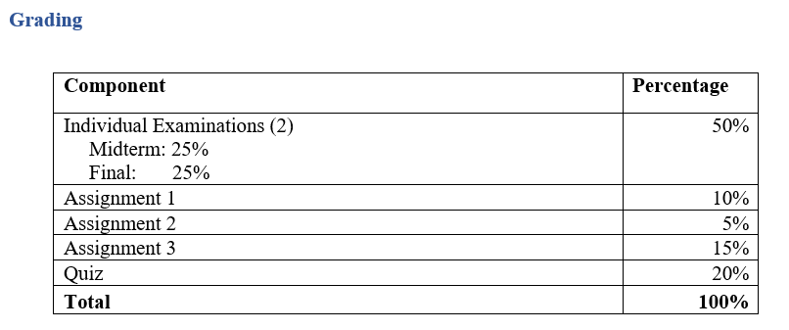

Slide 14
Lectures
Outline in syllabus
Deviations possible (probable)
Please ask questions if you need help

Slide 15
Class Schedule
[Adjustments may be necessary]­
Session 1 3 January 2024 | Introduction to course The nature of data Introduction to conceptual modeling | Read syllabus Chapter 1
Session 2 6 January 2024 (Saturday 8:00 am) | Conceptual modeling (Chen and Crow’s Feet notations) Min/max cardinalities | Chapter 5
Session 3 10 January 2024 | Logical design Relational model Transformation of conceptual models to logical models SQL: DDL / DML | Chapter 3 Due: Assignment 1 (4:00 pm)
Session 4 17 January 2024 | Single table queries Multiple table queries | Chapter 2

Slide 16
Class Schedule (Cont’d)
Session 5 24 January 2024 | SQL (cont’d) Business intelligence and data mining Midterm examination (closed book, closed notes) | Chapter 12
Session 6 31 January 2024 | Reverse engineering Disruptive technologies Quiz (SQL, closed book) | Due: Assignment 2 (4:00 pm)
Session 7 7 February 2024 | Big data, data privacy, data ethics | Chapter 13 (big data)
Session 8 14 February 2024 | Course wrap-up Final Examination (closed book) | Due: Assignment 3 (4:00 pm)

Slide 17
Communication
GSU email is the official communication channel between the instructor and the students. Please do not use the iCollege’s email application for communicating with the instructor. The email address assigned by iCollege is not recognized by the GSU Outlook email server. Thus, email messages initiated from iCollege cannot be replied.
vstorey@gsu.edu
(Might get reply from mobile.)
Office Hours: By appointment. Before/after class.
Administration today
Name tags
Group formation (iCollege)

Slide 18
QUESTIONS
?

